Slide 1
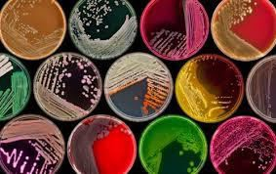
Cultivating Microorganisms: A Journey into Culture Media Practical Lecture 1
by: Abdurraouf Alhatmy

Slide 2
Culture media can be classified according to their:
Physical states (Forms of media):
Solid media.
Function:
Basic media
Enriched media
Enrichment media
Selective media
Differential media
Transport media
Semi-solid media.
Liquid media.

Slide 3
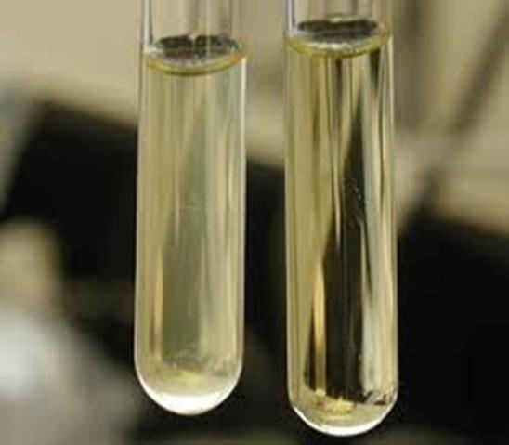
Forms of Culture Media
Liquid form:
Called: broth.
Without agar (solidifying agent).
Used to grow bacteria in large quantity.
Growth of bacteria-----> turbidity
No growth ----> clear

Slide 4
Solid form:
With agar (1-2% agar).
Solid media can be:
Slant: a tube containing solid media that was left to solidify at an angle. Used to keep the bacteria for long period of time (3 months)
Deep agar: agar solidified at bottom of tube. Used to keep the bacteria for long time (6 months or more).
Plate: used mostly to culture organisms, and to get pure culture of bacteria (isolated colony).
Semi-solid agar:
Contains less agar than solid media (0.5% agar).
Used as transport media, and for motility and biochemical tests.

Slide 5
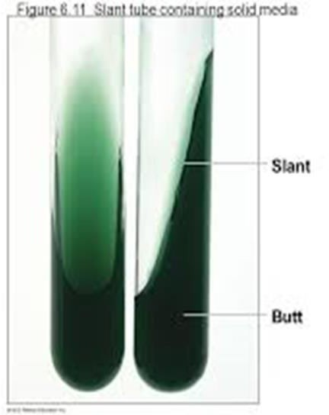
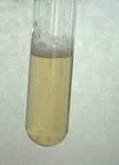
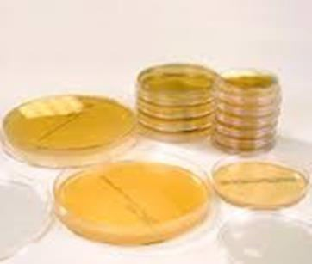
Deep
Slant
Agar plate

Slide 6
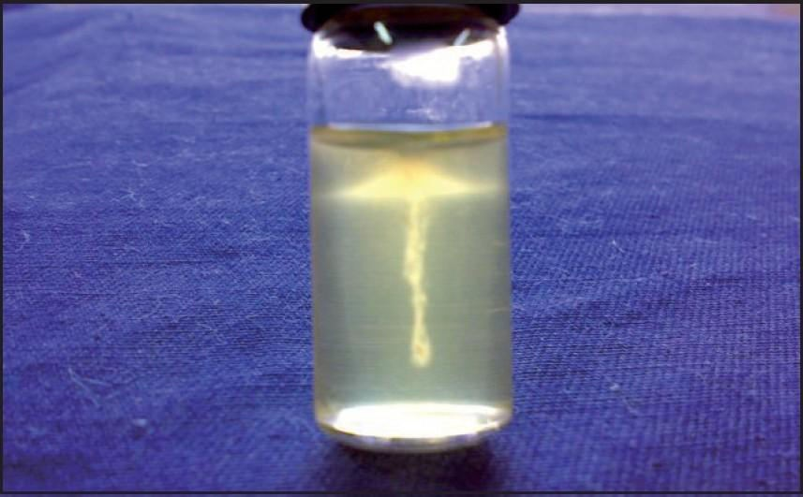
Motility in semi-solid media

Slide 7
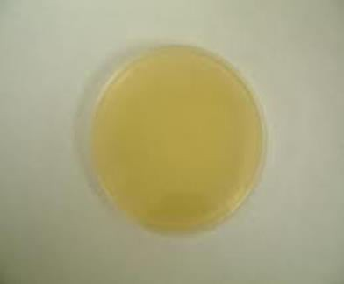
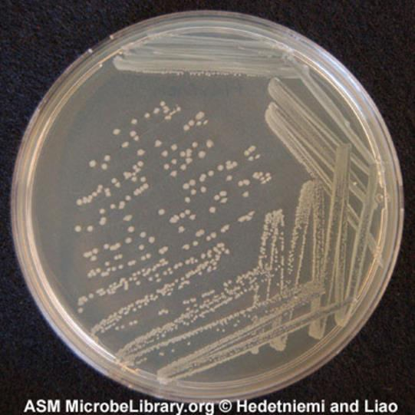
Types of Culture Media According to their Functions
Basal media:
It’s simple media, such as: nutrient agar (NA) and nutrient broth.
It allow the growth of non fastidious (do not have special nutritional requirements) or non-pathogenic bacteria.
Used in preparation of enriched media and to maintain stock culture of bacteria.
For the culture: notice the shape, margin, elevation, color, size, smell of organism.

Slide 8
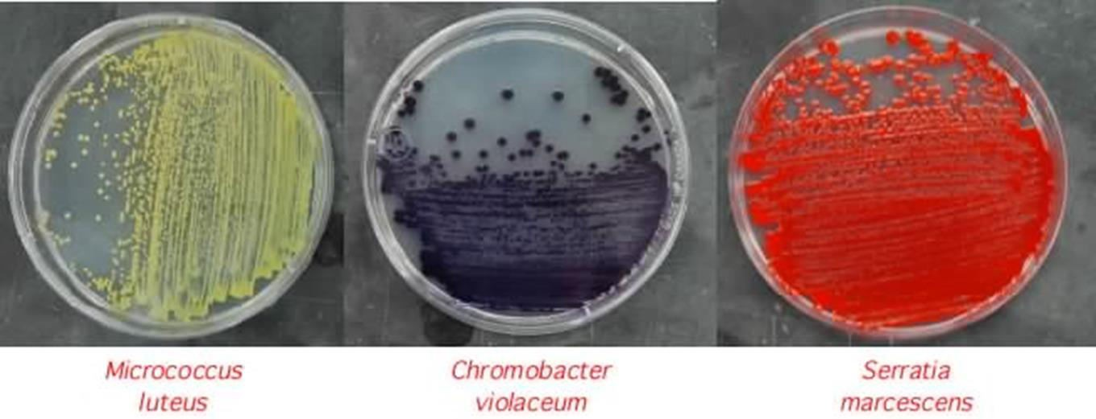
Notice pigment production by organism

Slide 9
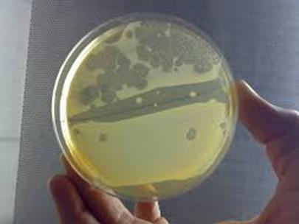
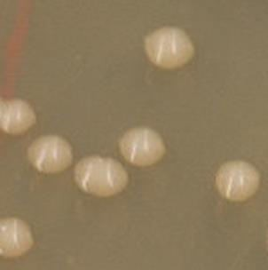
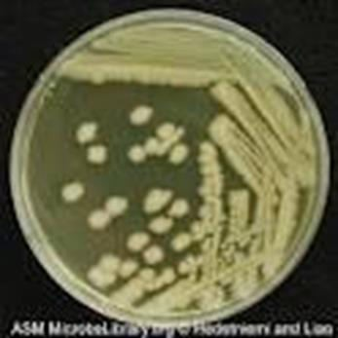
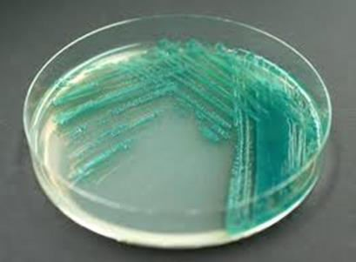
Klebsiella spp.
Bacillus
Pseudomonas

Slide 10
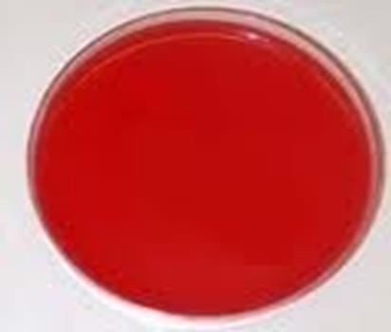
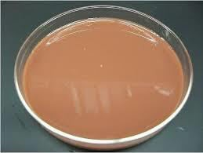
Enriched media:
It is basal media has been enriched by adding blood, serum or protein.
It allow the growth of fastidious and pathogenic bacteria.
Ex: Blood agar (BA), Chocolate agar.

Slide 11
Selective media:
It contains inhibiting agents that inhibit some organisms and allows others to grow.
Inhibiting agents: bile salt, dyes, antibiotics.
Examples:
Macconkey agar (Mac):
Inhibiting agent>> bile salt & crystal violet.
It allow the growth of gram-negative bacteria and inhibit the growth of gram-positive bacteria.
Eosin Methylene Blue agar(EMB):
Inhibiting agent>> methylene blue
It allow the growth of gram-negative bacteria and inhibit the growth of gram-positive bacteria.

Slide 12
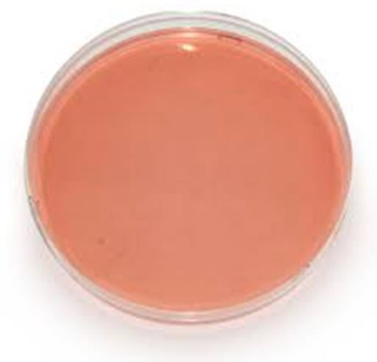
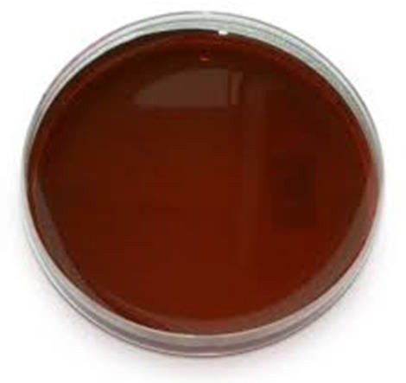
Mac
EMB

Slide 13
Differential media:
Contain indicator which differentiate between two types of bacteria.
Examples:
Mac:
Sugar Lactose.
Indicator Neutral red.
Used to differentiate between lactose fermenting (LF) & Non-lactose fermenting (NLF) bacteria.
LF>> pink colonies NLF>> yellow colonies

Slide 14
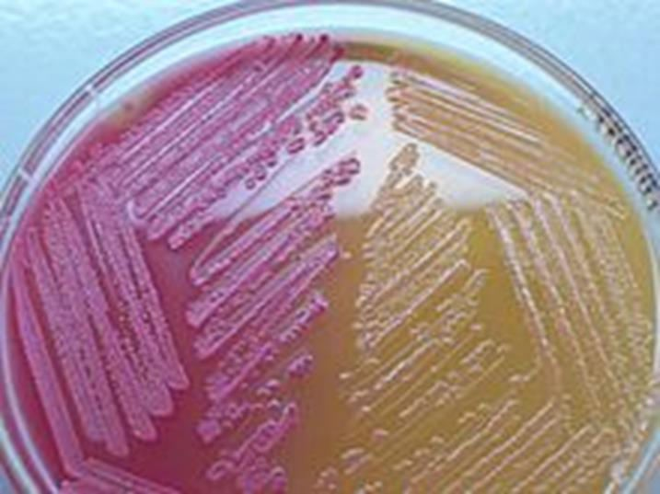
Mac

Slide 15
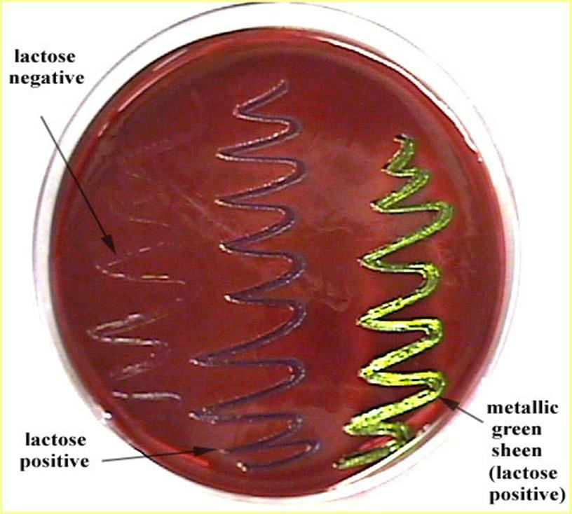
EMB:
Sugar Lactose.
Indicator Eosin and Methylen blue.
Used to differentiate between LF & NLF bacteria.
LF>> pink colonies (dark purple)
NLF>> colorless colonies
E.coli: LF produce “green metallic sheen” colonies

Slide 16
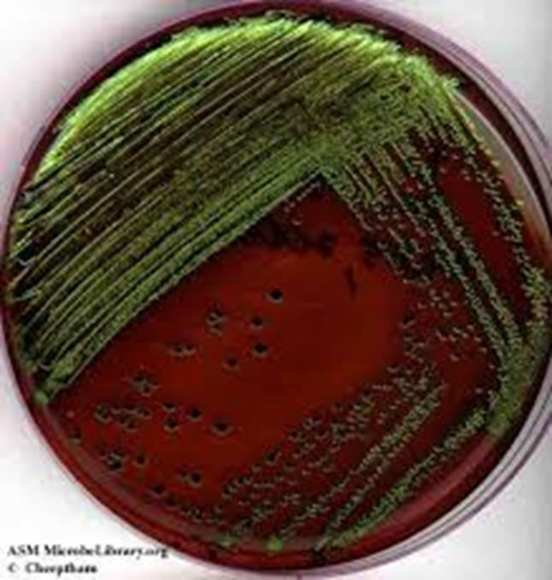
E. coli on EMB

Slide 17
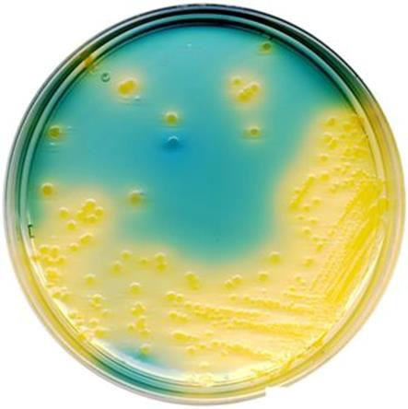
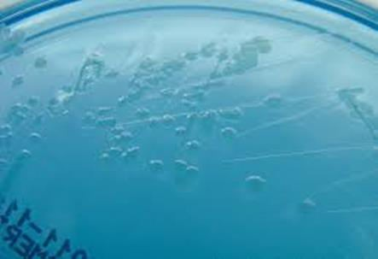
Cystine Lactose Electrolyte Deficient (CLED):
Sugar Lactose
Indicator Bromothymol Blue
Used between bacteria.
to differentiate LF and NLF
LF>> yellow colonies
NLF>> colorless colonies

Slide 18
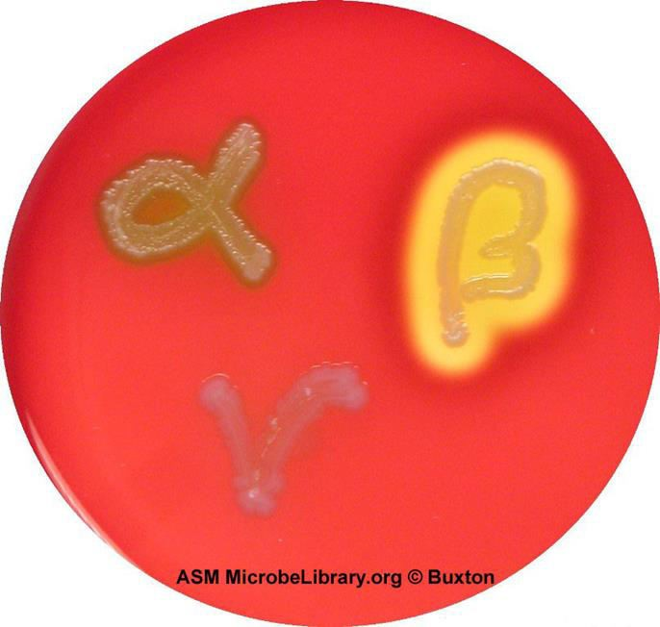
Blood Agar:
Used to differentiate between different types of hemolysis.
Types of hemolysis:
α Hemolysis β Hemolysis γ Hemolysis

Slide 19
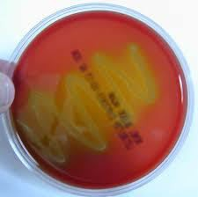
Types of Hemolysis
α hemolysis:
Incomplete hemolysis
greenish color around colonies

Slide 20
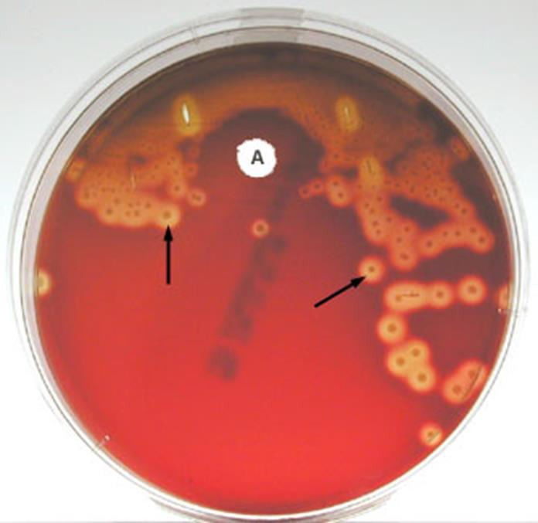
β hemolysis:
Complete hemolysis
Clear area around colonies.
γ Hemolysis:
No hemolysis

Slide 21
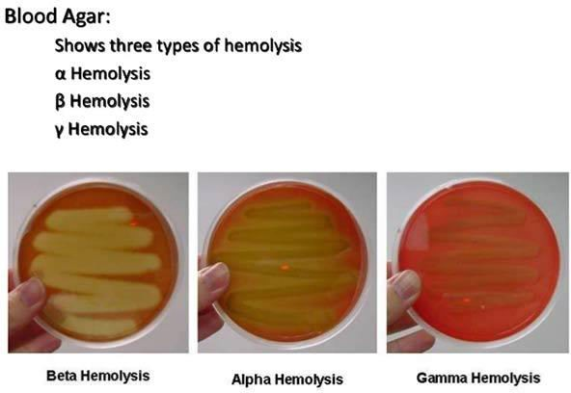

Slide 22
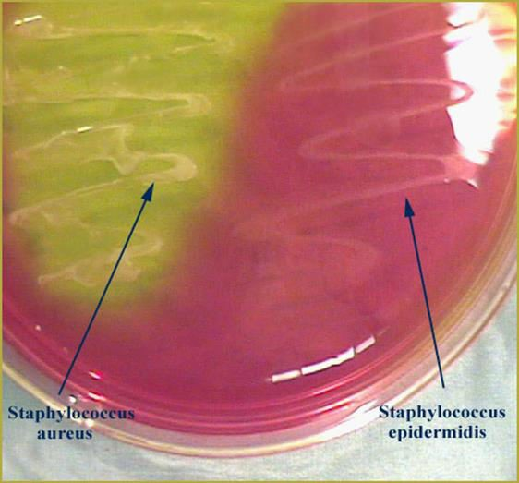
5. Selective and Differential media:
Example:
A) Mac
B)EMB
C) Mannitol Salt Agar( MSA)
Inhibiting agent: high
salt
concentration 7.5%
Only organisms tolerate high salt grow on it.
Sugar Mannitol Phenol red
that can conc. can
Indicator
The organism that ferments mannitol give yellow color colonies, if organism does not ferment mannitol no change in color (colorless)

Slide 23
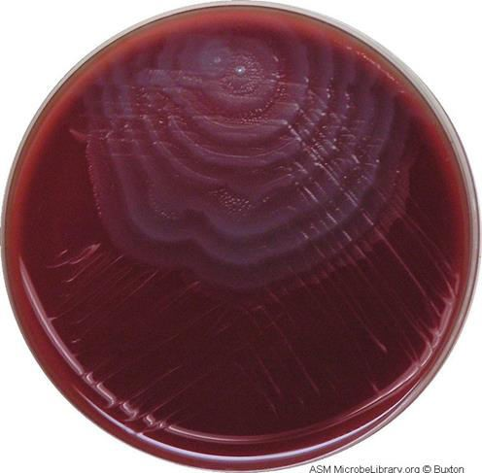
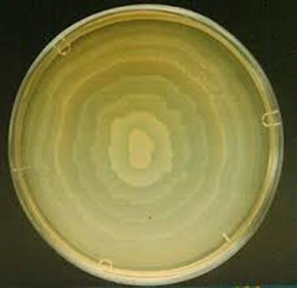
Swarming of Proteus
Swarming appear as spreading rose on BA and NA plates.
CLED inhibit swarming.

Slide 24
Thank you

